Slide 1
Absolute Location
6.Ge.4

Slide 2
What is absolute location?
Absolute location: the location of a place using latitude (North/South) and longitude (East West) coordinates.
Hint:
Whenever we write absolute location, we write North/South first

Slide 3
Relative Location
Relative Location: the location of a place in relation to another place
Example: Columbus is 32 miles west of Newark Australia is Southeast of Asia

Slide 4
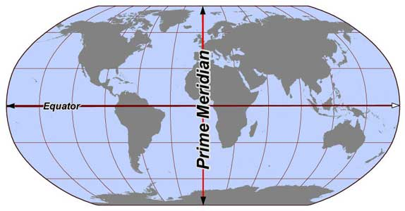
Equator vs. Prime Meridian
Equator: the line of latitude that separates the Northern and Southern Hemisphere
Prime Meridian: the line of longitude that separates the Eastern and Western Hemisphere

