Slide 1
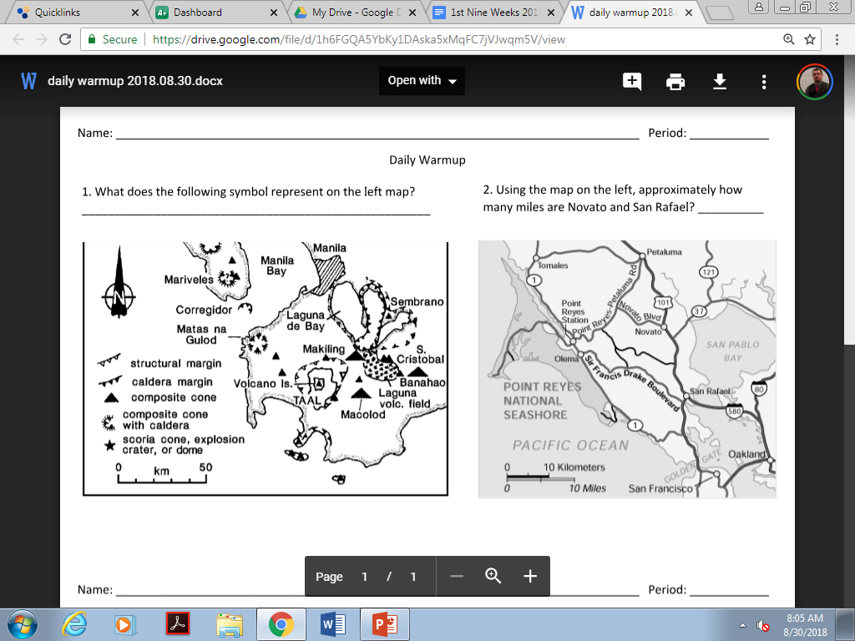

Slide 2
Geographic Tools & Maps

Slide 3
Vocabulary
Maps
Globe
2-dimensional (2-D)
Easier to carry
Because they are flat, they are not as accurate
Best for close-up areas
3-dimentional (3-D)
Difficult to carry
100% accurate
Best for large areas/continents

Slide 4
Vocabulary
Key/Legend
Shows what symbols on a ma represents
Scale
Shows how large an area on a map is

Slide 5
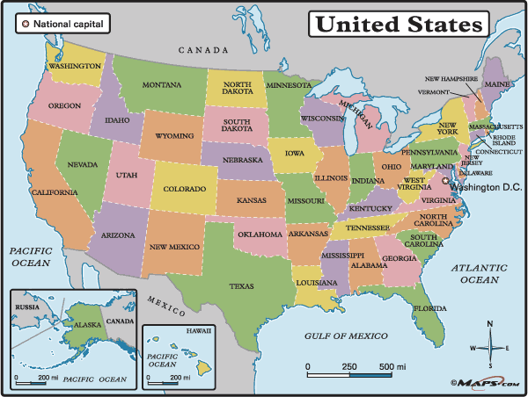
Vocabulary
Cartographer
Mapmaker
Compass Rose
Shows Cardinal Directions (North, South, East, West), and Sometime Intermediate Directions (NW, SW, NE, SE)

Slide 6
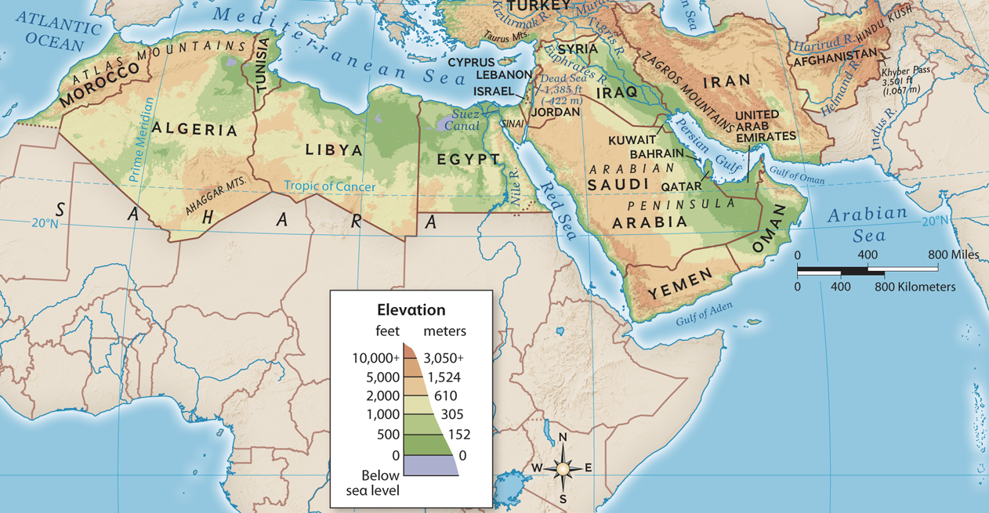
Let’s Practice Identify the parts of the map
Key/legend
Scale
Compass Rose

Slide 7
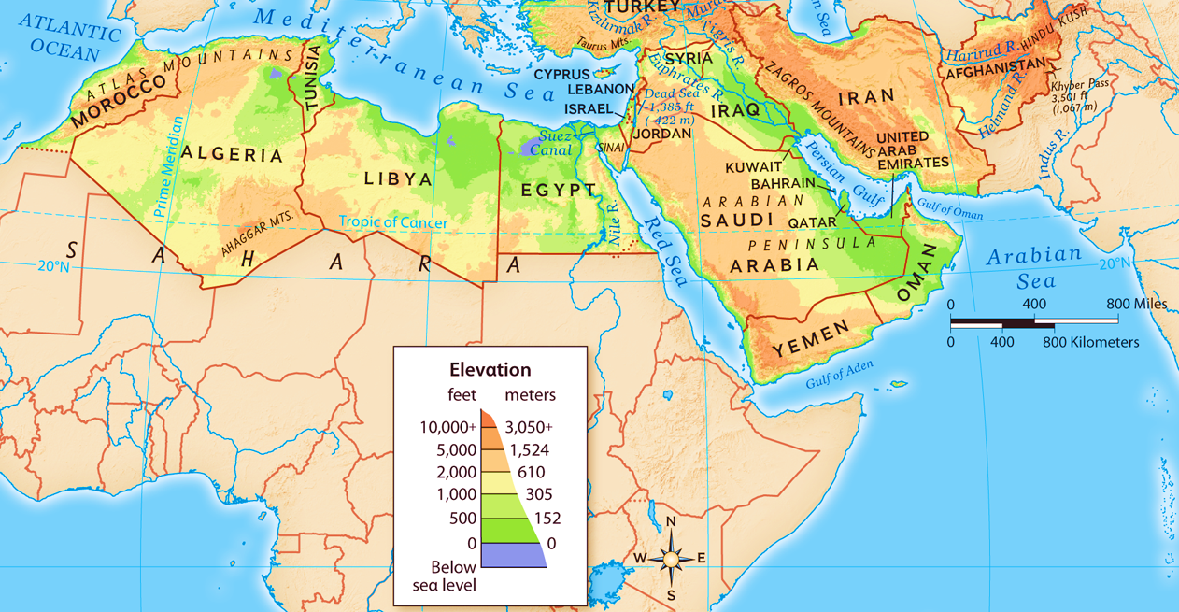
Let’s Practice What is the approximate height of Egypt’s highest point?

Slide 8
Let’s Practice What is the approximate height of Egypt’s highest point?
About 5,000 feet above sea level

Slide 9
Let’s Practice About how far are Oman and Egypt?

Slide 10
Let’s Practice About how far are Oman and Egypt?
About 800-1,000 miles

Slide 11
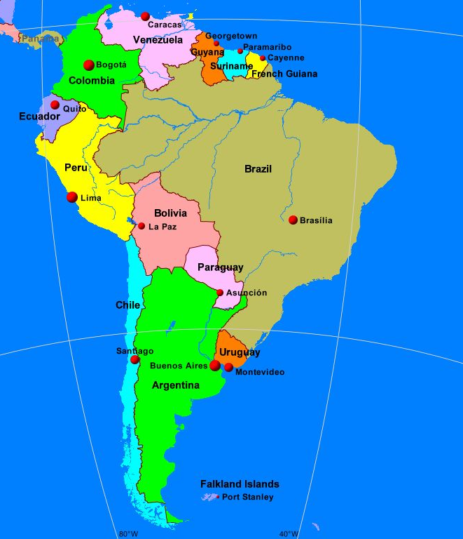
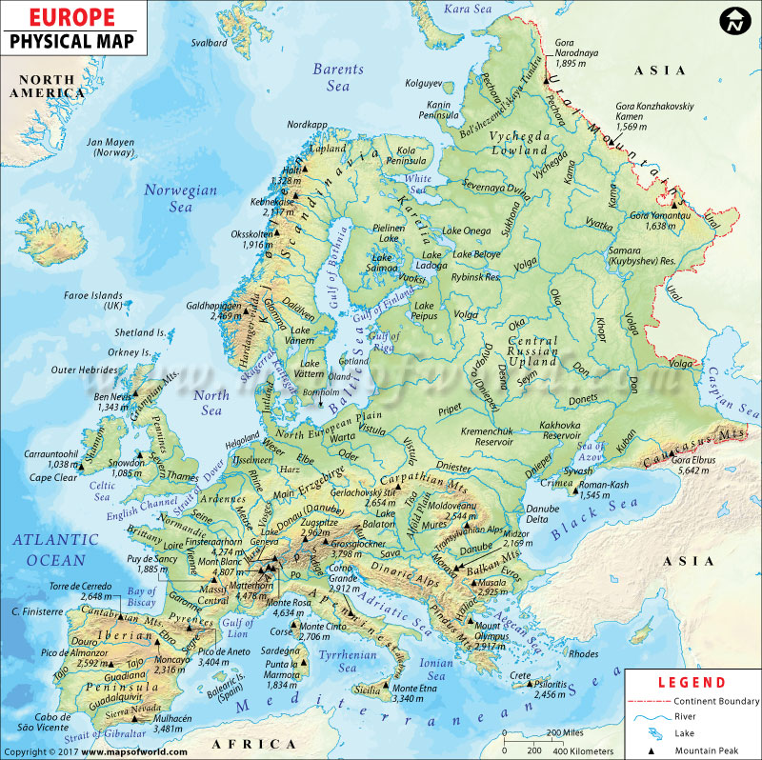
Types of Map
Political Maps
Physical Maps
Government boundaries (states and countries)
Geographic features (mountains, rivers, islands, deserts)

Slide 12
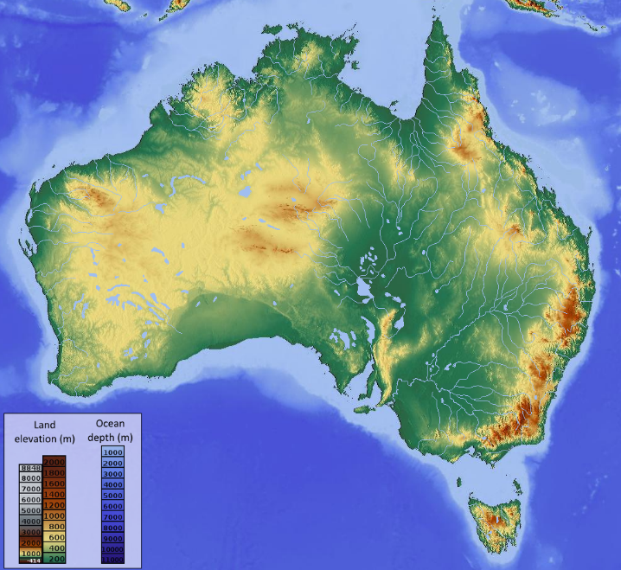
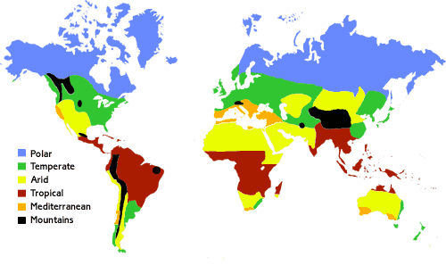
Types of Map
Topographical Maps
Climate Maps
Type of physical map that includes elevation (how far above sea level
Average weather, such as precipitation (rain and snow) and temperature

Slide 13
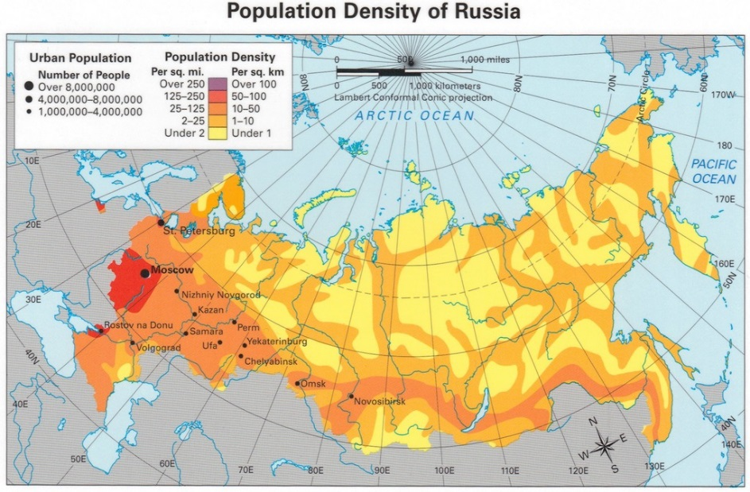
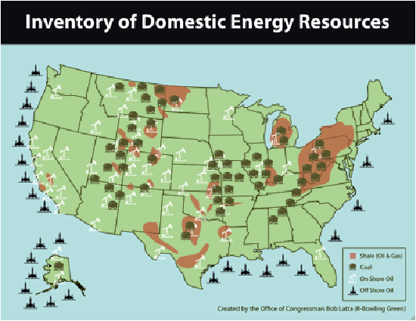
Types of Map
Population Density Map
Product Maps
How many people live in an area (such as 100 people per square mile)
Natural resources (things that come from nature) available in an area

Slide 14
Let’s Practice Name that map!

Slide 15
Let’s Practice Name that map!
Topographical Map
(see how it shows the elevation)

Slide 16
Let’s Practice Name that map!

Slide 17
Let’s Practice Name that map!
Political Map
these maps usually show each country as a different color)

Slide 18
Let’s Practice Name that map!

Slide 19
Let’s Practice Name that map!
Population Density Map
The legend at the top
uses the key
word “population”

Slide 20
Let’s Practice Name that map!

Slide 21
Let’s Practice Name that map!
Physical Map
The map focuses on the
physical features of Europe,
such as mountains and rivers

Slide 22
Let’s Practice Name that map!

Slide 23
Let’s Practice Name that map!
Climate Map
The key is showing the various climates

Slide 24
Other Geographic Tools
Aerial Photographs
Digital Satellite Images
Photos taken from high above the Earth
Images taken from satellites in outer space
Historical Maps
Maps from the past

